Slide 1


SolSaviour: A Defending Framework for Deployed Defective Smart Contract
Zecheng Li
Yu Zhou
Songtao Guo
Bin Xiao

Slide 2
Background
Smart contracts attract lots of attacks
The DAO hack → 3.6M ETH loss
1st Parity Multisig hack → 153,037 ETH loss
2nd Parity Multisig hack → 513,774.16 ETH loss
Smart contracts are in danger
Currently, smart contract market size approaches ~ USD 200 Million
New applications such as DeFi requires more vigorous defense

Slide 3
The DAO hack – An Example
The DAO
Honest
Stake Holders
Attackers
Honest stake holders cannot do anything but to withdraw assets following the attacker's way
Why defending a deployed smart contract is challenging?

Slide 4
Problem Statement
How to protect assets in defective deployed smart contracts?
1. Smart contracts cannot be modified once deployed
  hard to patch via changing code
2. Verification is not enough
  false positive cases
  limited type of vulnerabilities
  deployed contracts are vulnerable to unknown bugs
The only proper way to protect a smart contract is to fix potential risks in its code before it is deployed to the blockchain
– SMARTSHEILD (SANER’20)

Slide 5
Existing Work
Existing work on protecting deployed defective smart contracts
Sereum (NDSS’19)
  defend against reentrancy attacks + runtime monitoring and validation
ÆGIS (AsiaCCS’20)
  detect attacks by matching attack patterns
EVMPatch (USENIX Security’21)
  can patch reentrancy and integer overflow bugs with proxy pattern

Slide 6

Limitations of Existing Work
Sereum (NDSS’19)
  can only defend reentrancy attacks
ÆGIS (AsiaCCS’20)
  matching real attacks with attack patterns is hard
EVMPatch (USENIX Security’21)
  can patch reentrancy and integer overflow bugs
Common Limitations
cannot save assets from defective contracts
cannot defend against unknow bugs in deployed smart contracts

Slide 7

Our Solution
SolSaviour
A framework for repairing and recovering defective deployed smart contracts
voteDestruct mechanism
  destroy the defective deployed contract in a distributed way
TEE cluster
  deploy a patched smart contract to replace the defective one
Assets
unknown bugs

Slide 8
SolSaviour Overview
Honest
Stake Holders
voteDestruct
Patched
Contract
A good deployed contract might be defective.
Honest stake holders can destroy defective contracts via voteDestruct mechanism.
Assets are held by TEE cluster temporarily.
Honest stake holders provide patched contract to TEE cluster.
TEE cluster deploys the patched contract and migrates the state of destroyed defective contract to it.
Asset
Escrow
TEE
Cluster
Deployment of
Patched Contract
State Migration
Not
Exploitable
Exploitable
Defective
Contract
Patched
Contract
Attacker

Slide 9
voteDestruct Mechanism
Record stake distribution
  record the amount of deposited assets of stake holders
Lock/Unlock smart contract
  prevent defective contracts from further exploits
Vote based on stake
  vote to decide whether to destroy the defective smart contracts
  the defective contract can be destroyed once voting passes threshold
stake_holder_1
stake_holder_2
stake_holder_3
stake_holder_3
stake_amount
stake_amount
stake_amount
...
stake_amount
voted
voted
voted
voted

Slide 10
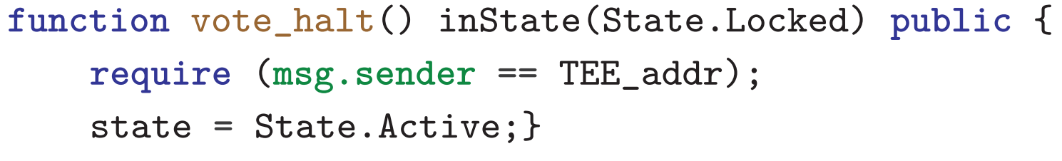
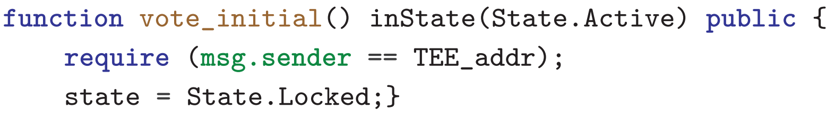
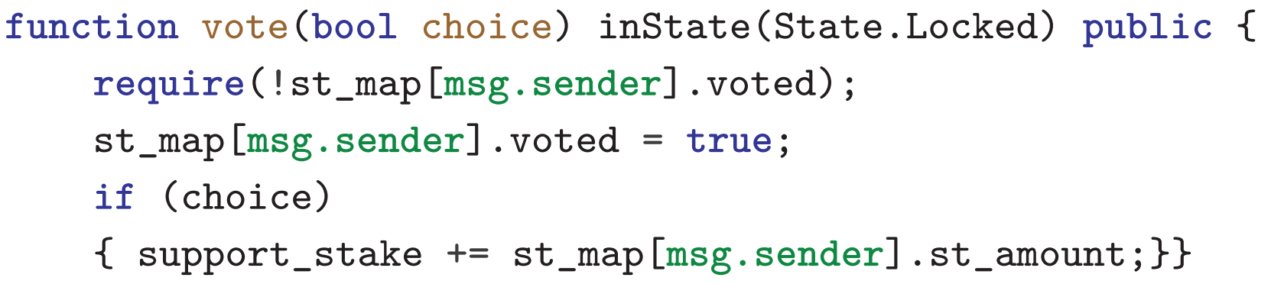
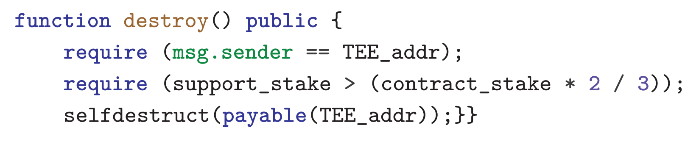
Contract State Changes
Active
a bug occurs
Defective
lock the contract
vote_initial()
unlock
vote_halt()
Destroyed
selfdestruct
Locked
destroy()
vote
vote()

Slide 11
TEE Cluster
Bootstraping
  generate a unique blockchain address and act as a single blockchain account
TEE Message Call
  generate signed message call transactions to invoke voteDestruct-enabled smart contracts
Asset Escrow
  hold assets from destroyed defective smart contracts temporarily
State Migration
  deploy patched smart contract to replace defective contract
  deposit temporarily-held assets to patched contract according to stake distribution

Slide 12
Bootstrapping
TEE nodes coordinately generate a unique key during the bootstrapping
  unbiased
  confidentiality
No external entities
  can acquire the key previously
  can act as TEE cluster to invoke smart contracts
TEE
n₁
TEE
n₂
k₁
k₂
addr
K
k₃
k₄
TEE
n₃
TEE
n₄

Slide 13
TEE Message Call
Generate a message call transaction
  address of defective contract
  contract ABI
  function selectors - vote_initial(), vote_halt(), destroy()
  no need to encode arguments
Sign the generated message call transaction with the unique key
Let TEE host broadcast the transactions

Slide 14
Asset Escrow
Invoke the destroy() function
  destroy defective contract
  transfer assets to the account controlled by the TEE cluster
Safe Exit
  refund escrow assets back to stake holders
  escape from a potential asset loss successfully
Not Enough
Stake holders may want to continue the execution of smart contract

Slide 15
State Migration
Redeployment of Patched Contract
  stake holders prepare a patched smart contract
  Stake holders upload the contract to TEE cluster
  TEE cluster deploys the patched smart contract
State Migration
  hardcoded the stake distribution in patched smart contract
  deposit the temporarily-held assets into deployed patched contract

Slide 16
Safe Exit
voting
Defective
Locked
Safe
first
deployment
invoke
vote_initial()
invoke
destroy()
provide
contract
TEE Cluster
an honest
stake holder

Slide 17
Recovering
voting
Defective
Locked
Safe
first
deployment
invoke
vote_initial()
invoke
destroy()
deploy
patched
contract
state
migration
TEE Cluster
provide
contract
an honest
stake holder

Slide 18
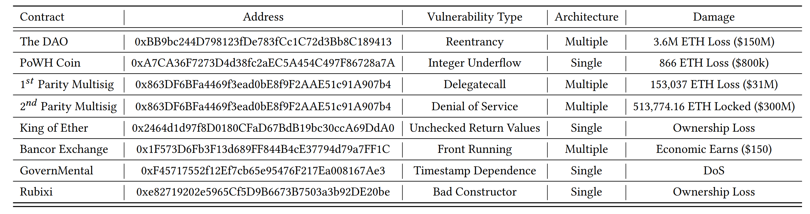
Dataset
We collected contracts that were under attacks

Slide 19
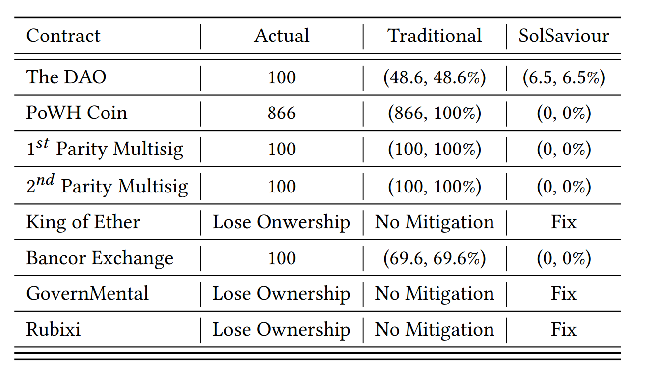
Effectiveness
SolSaviour can repair recover all defective contracts
Actual loss in different settings
  No defense
  Traditional defense
  SolSaviour defense

Slide 20
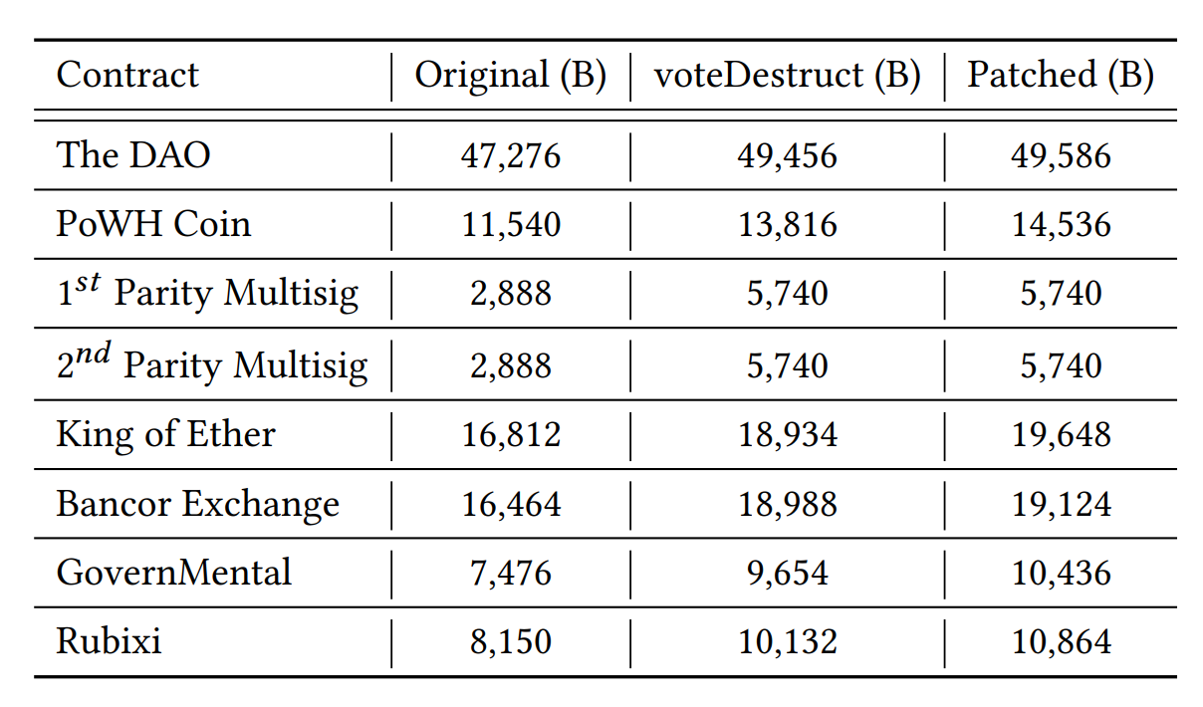
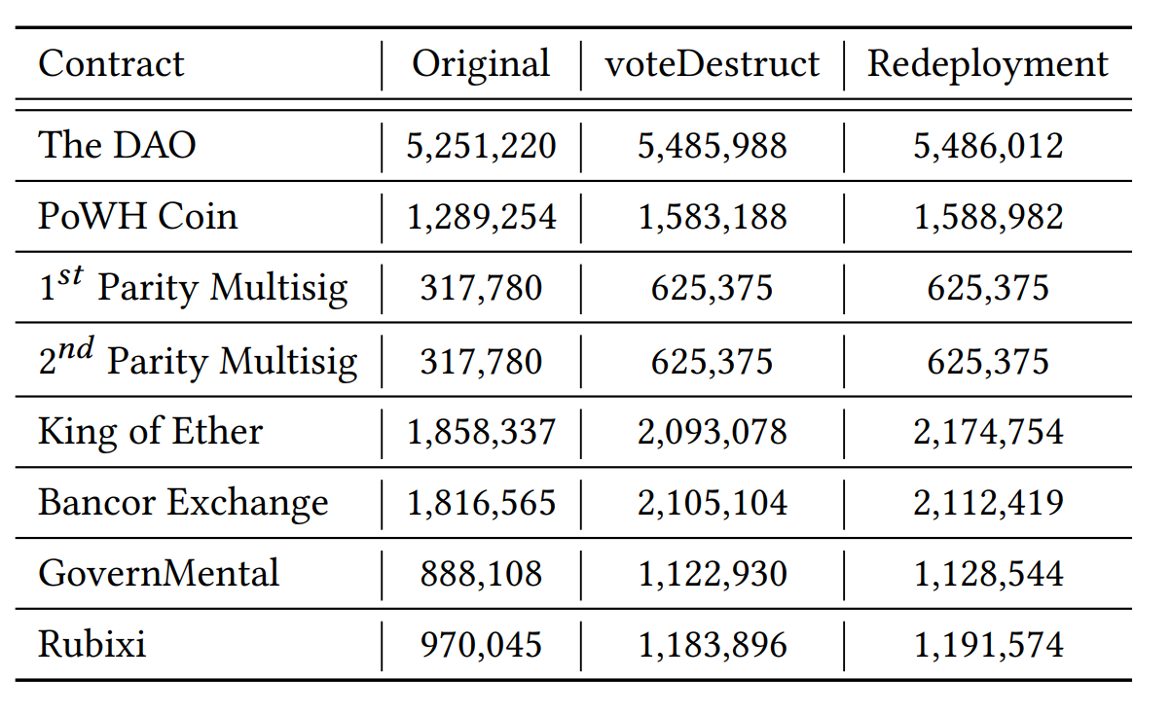
Overhead
Code Size Increase
Gas Consumption

Slide 21
Summary
SolSaviour
Repair and recover defective deployed smart contracts
First work to save assets from defective deployed contracts!
First work to defend against unknown bugs!
Thanks for your listening!

